Slide 1
E- Pass
College name
Students Name: reg. No.
1.
2.
3.
4.
5.
Under The guidance of:
Prof.

Slide 2
Introduction
E- Pass Generation system is a web application for students to get bus passes through online
This system was intended to develop an application for K, S.R.T.C to perform functionalities like accessing the basic information of a student from educational institutions for authentication and provide Bus pass to a particular student without placing him/her in a queue for a long time.
This System keeps all information of all types of Bus pass.

Slide 3
Scope
Using this system we can check all details related Bus pass and instruction like how to renew pass how to update it, and also provide details of student discount.

Slide 4
Goal
The main goal of the project is to Student can able to get Bus pass through Online Easily.

Slide 5
Existing System
Before this application implementation the manual process is used to do the process of issuing the Bus pass to the students. This Manual process requires man power and more time consuming. To avoid such difficulties we implemented this system.

Slide 6
Software Requirements
Operating System. : Windows XP,win 7 win8
Font End : HTML,PHP.
Developing Tool : Wamp server
Database : Mysql

Slide 7
Hardware Requirements
Processor : Pentium IV 2GHz and Above
RAM : 2GB RAM
Monitor : 15” Color Monitor

Slide 8
Project Modules
Student Registration
Student Login
Pass Applying
Payment
College Verification
KSRTC Admin

Slide 9
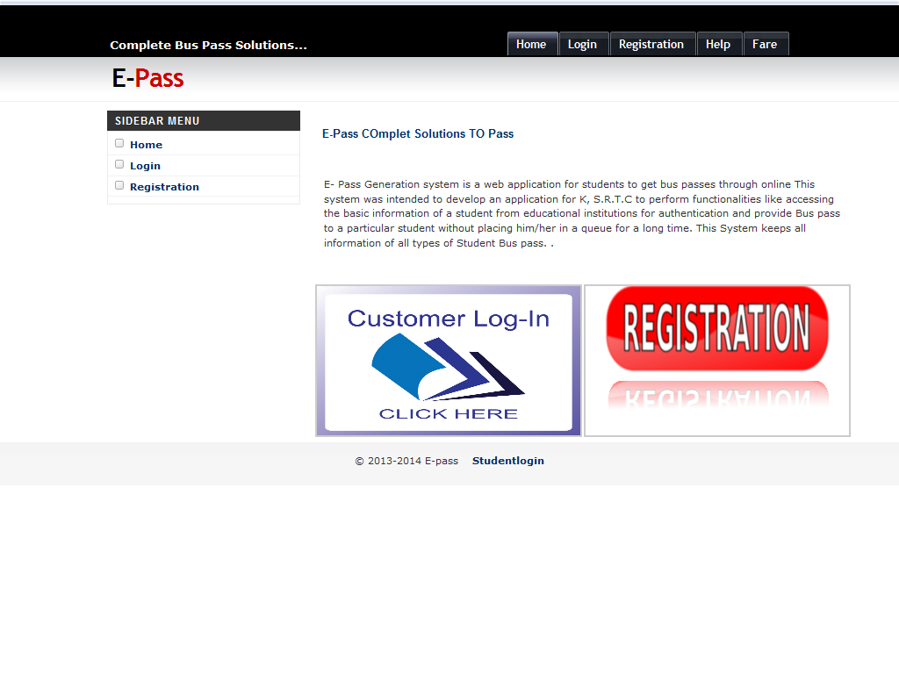
Home Page

Slide 10
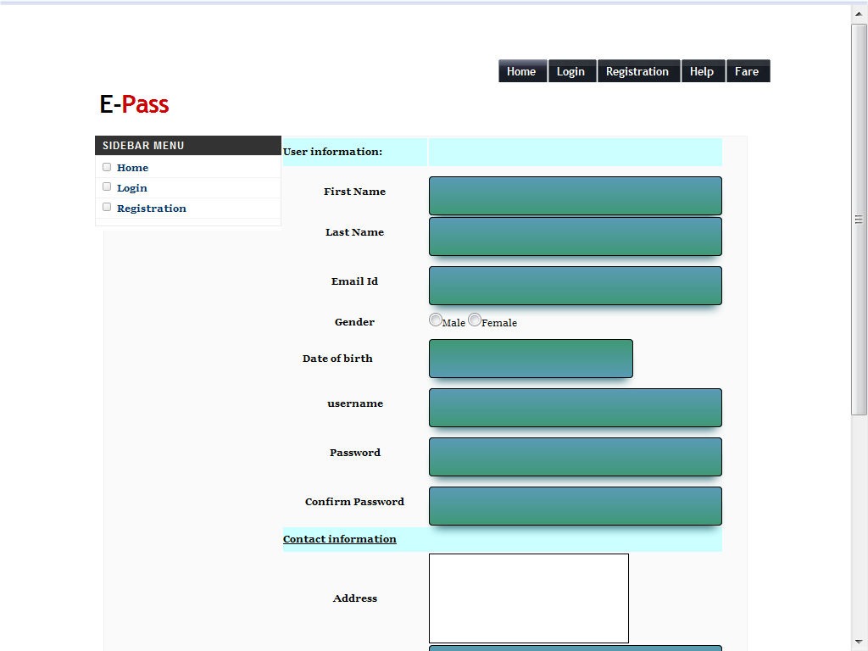
Student Registration

Slide 11
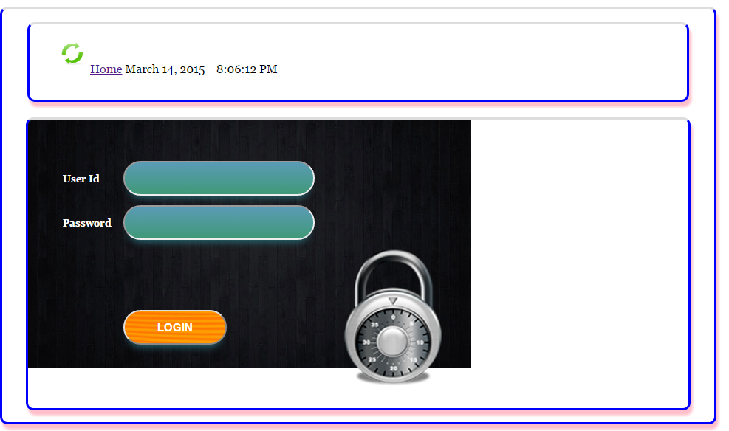
Student Login

Slide 12
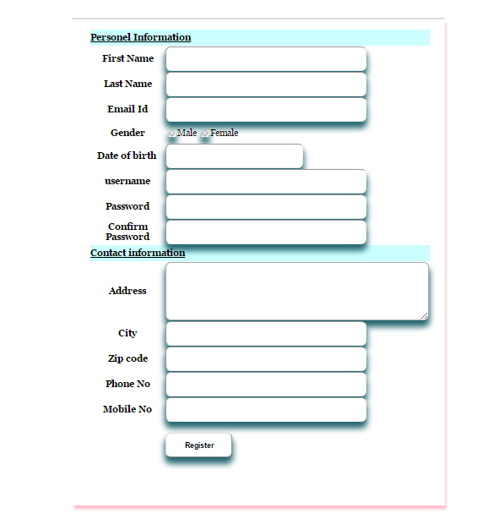
Pass Applying

Slide 13
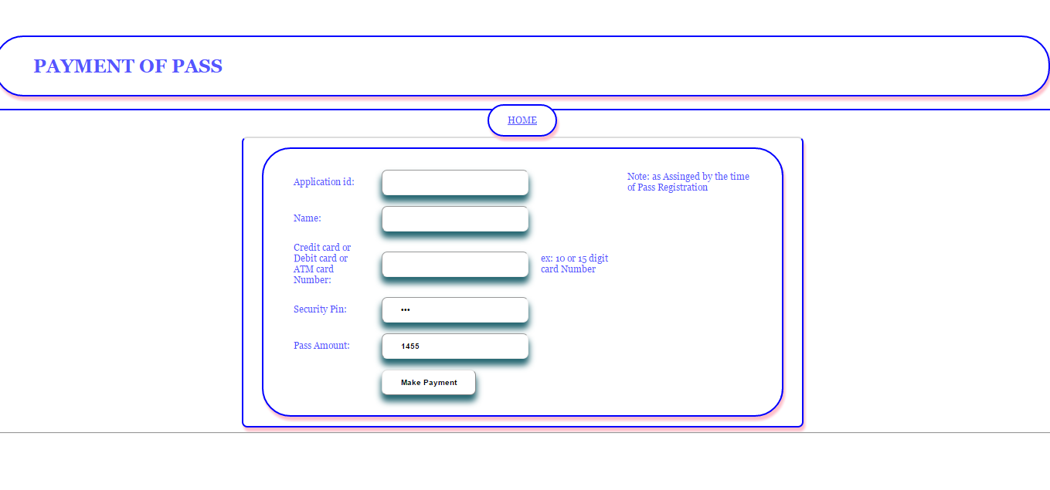
Payment

Slide 14
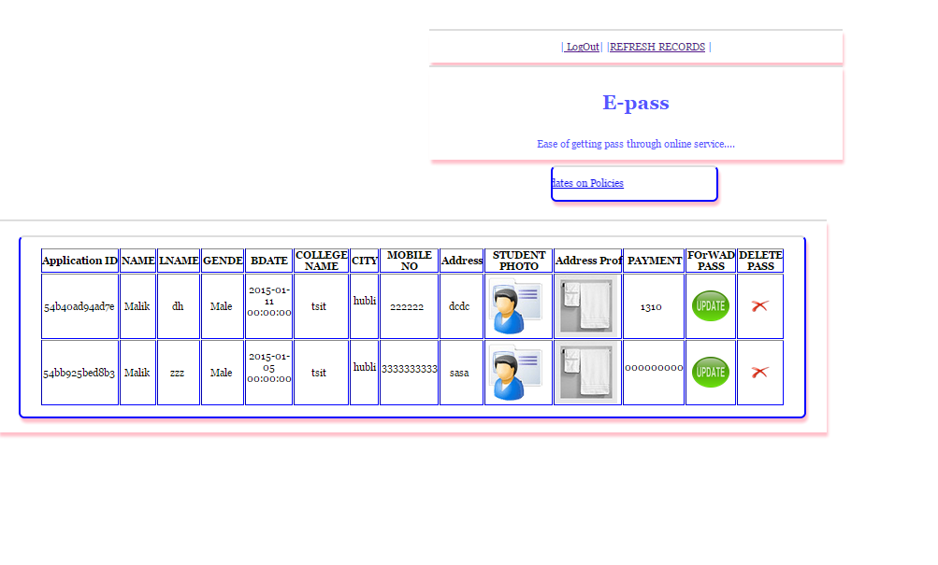
College Verification

Slide 15
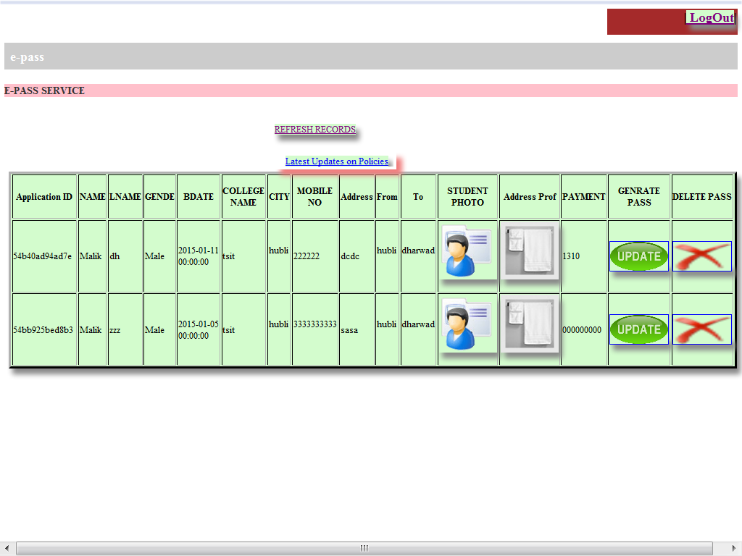
KSRTC Admin

Slide 16
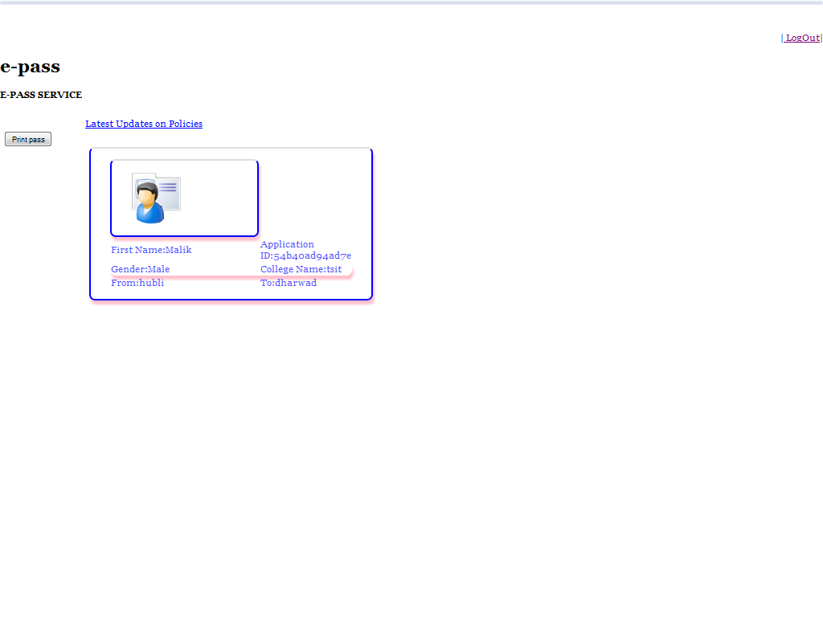
Pass genration

Slide 17

Testing
Unit Testing
Integration Testing
System Testing

Slide 18

References
1) PHP an Mysql - THE COMPLETE REFERENCE, 5TH EDITION
2) www.oracle.com
3) www.wikipedia.com
4) www.w3schools.com
5) www.tutorialspoint.com

Slide 19
Thank you

